Slide 1

Medical Compass

Slide 2
Introduction
A specialized digital brand dedicated to delivering accurate health information, aiming to simplify complex medical knowledge and promote the concept of prevention as the first step towards a healthier life.
**We focus specifically on six core areas: Diabetes, Sports & Fitness, Obesity, Mental Health, Ophthalmic Diseases, and Hyperbaric Oxygen Therapy (HBOT).
Through reliable content and collaboration with a selection of elite doctors and experts, we strive to present medical insights in an accessible and easy way for everyone.
Our vision is for accurate information to be the compass guiding every individual towards choosing a healthy and sustainable lifestyle

Slide 3
Business Model Canvas (BMC)
key parteners: meta | key activities: marketing review the medical information by specialied physician | value proposition : المعلومة الطبية المبسطة التعريف بالاطباء و المراكز الطبية المشهورة | relationships : mass customers | customer segment : medical students mothers who are worry about their childern’s health young professional
 |  |  | channels : social media website
 | key resources: content tools: canva , capcut, meta business suite HR: graphic designer , content creator
Cost sttructure: program subscrption like canva and capcut doctor reviews, meta ads , google ads , domain subscribtion , |  | Revenue streams: subscription for our ads

Slide 4
SMART Objectives :
Increase awareness among the target audience (ages 18-50) about six key health topics: Obesity, Diabetes, Pediatrics, Eye Diseases, Sports Medicine, and Oxygen Therapy through simplified and reliable medical content.
•Reach at least 2000 people on digital platforms within 6 months, with an
engagement rate of no less than 15% on posts.
•Produce 3 awareness posts per week, 2 short videos per month, and simplified articles in collaboration with 2-3 medical specialists to ensure credibility.
•• Within 6 months, deliver 72 awareness posts, 12 short.

Slide 5
SWOT Analysis
strength : Arabic-focused medical content filling a major market gap. varity of content formats like posts , images , videos up-to-date information | weakness: new brand most of the admin are not in the medical fields Potential misunderstanding of medical content. Difficulty in buildin g trust and engagment.
opportunities: Scarcity of reliable Arabic health platforms. Mobile app expansion for better accessibility. Collaborations with hospitals or public health bodies. Positioning as a regional health authority. | threats: Competition from major platforms (e.g., Altibbi, WebMD). Censorship or regulatory restrictions. Spread of misinformation without proper moderation. Reputation threats via fake reviews or cyberattacks.

Slide 6
Marketing Mix:
The marketing mix strategy for the mental health awareness campaign is based on the 4Ps framework—Product, Price, Place, and Promotion—designed to effectively deliver public health education.
The Product includes a digital platform offering free, high-quality Arabic mental health content such as videos, blogs, self-assessment tools, and expert-led webinars.
The Price model focuses on inclusivity, providing most services for free with optional low-cost add-ons like private consultations or exclusive content.
For Place, the campaign ensures wide accessibility through mobile-friendly platforms, social media channels, and messaging apps to reach users where they are most active.
Promotion centers on engaging and educational content marketing, partnerships with local influencers, live Q&A sessions, mental health challenges, and community-driven campaigns.

Slide 7
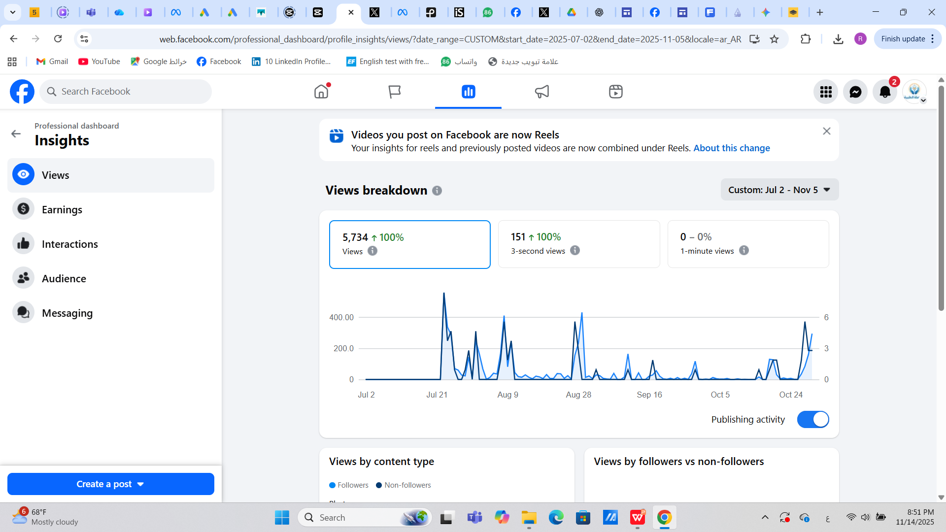
account analysis:

Slide 8
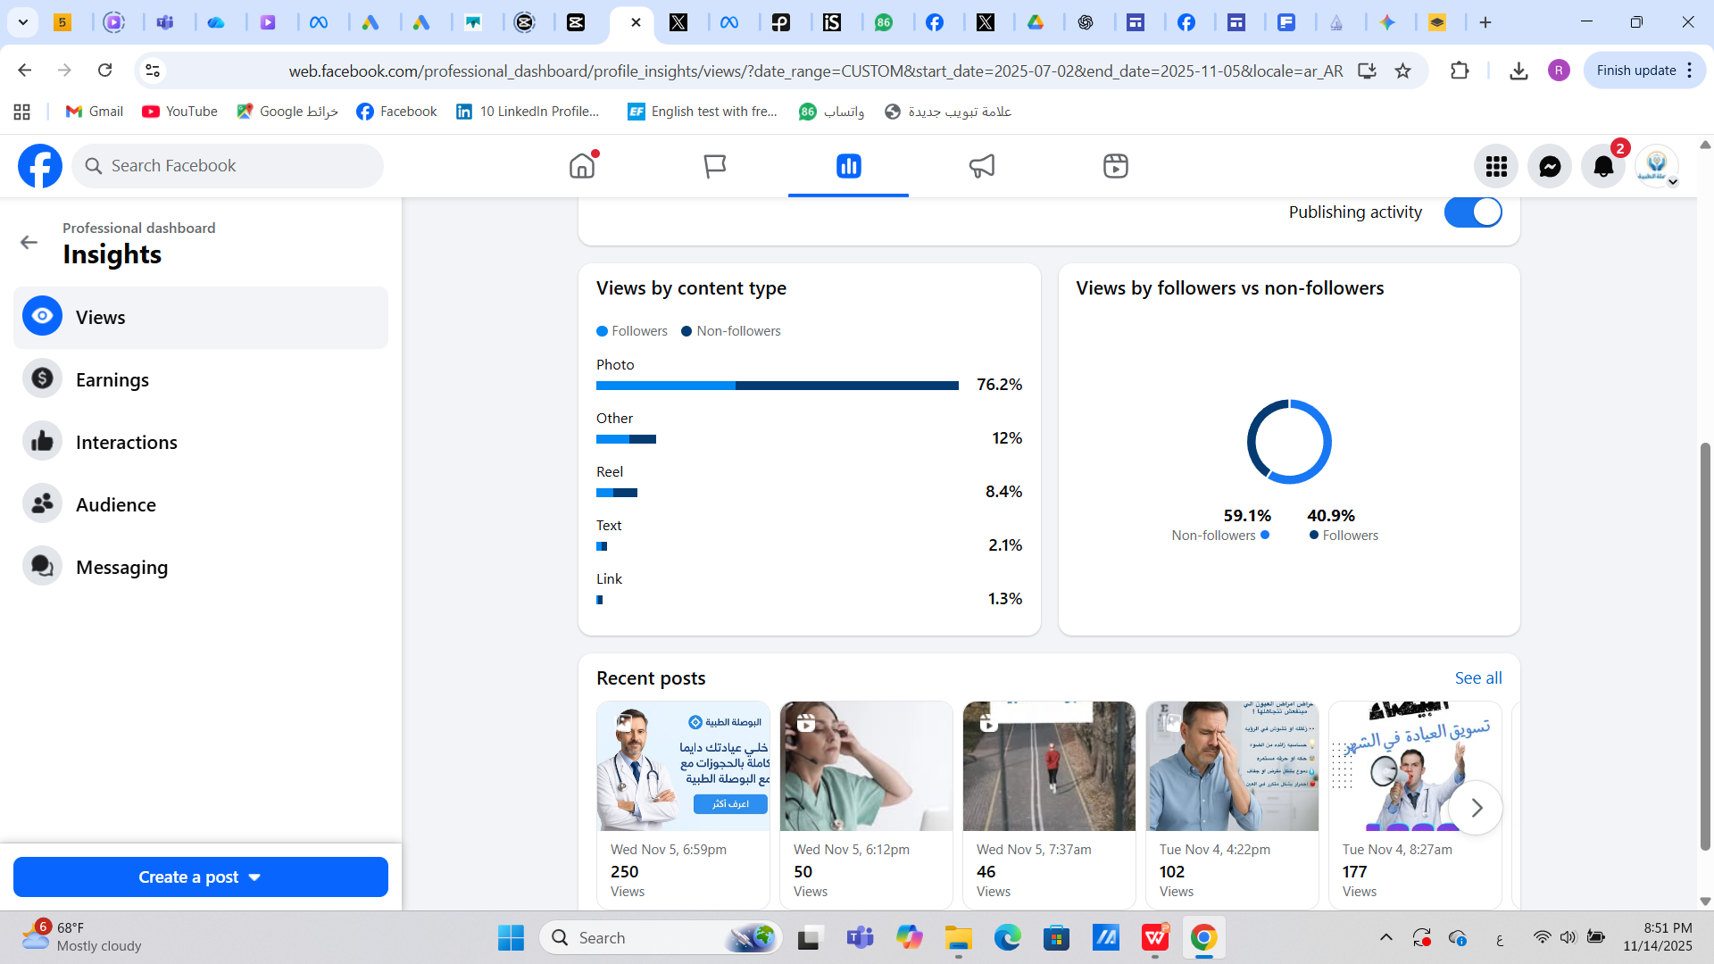

Slide 9
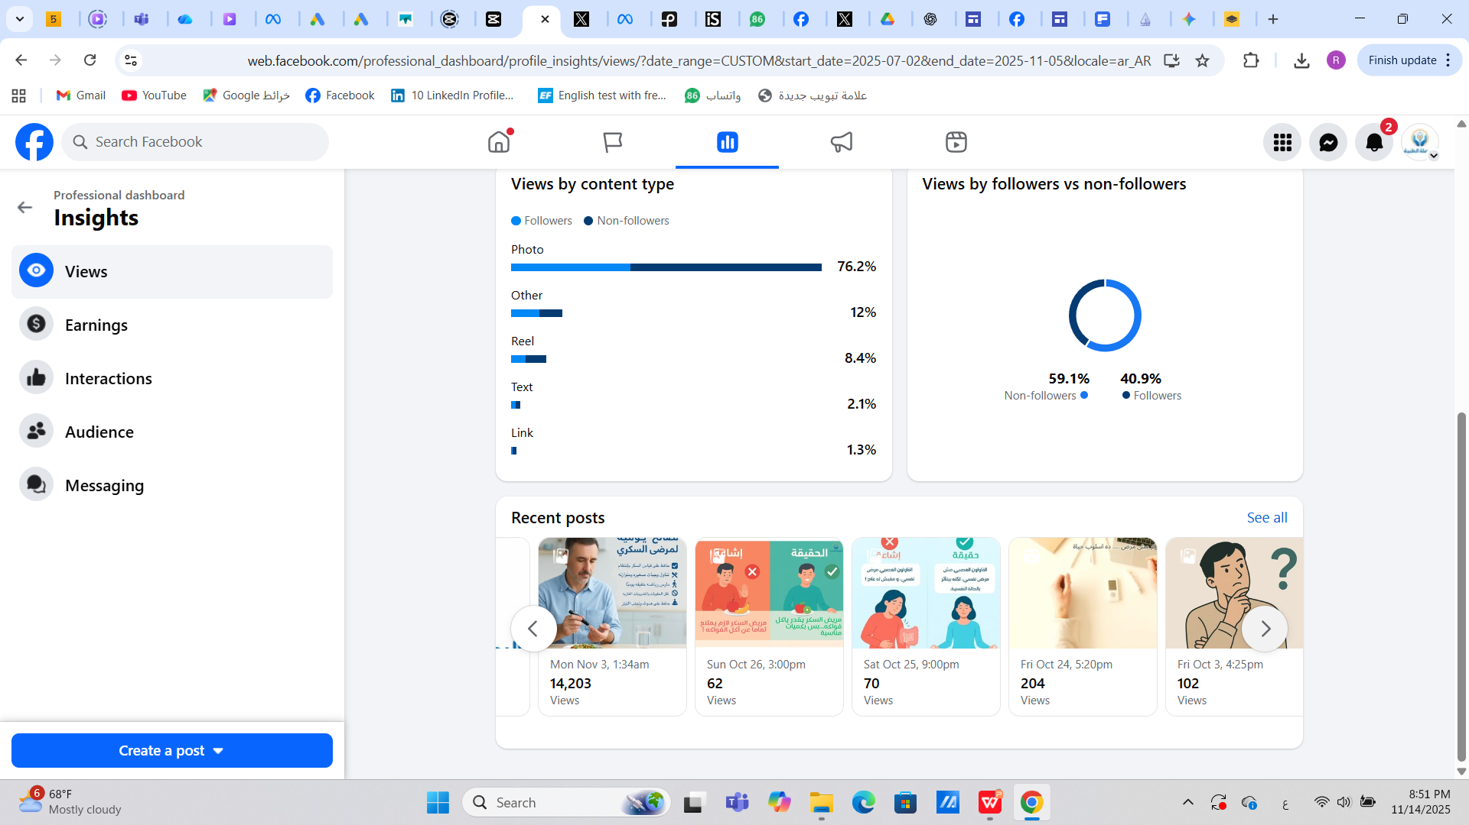
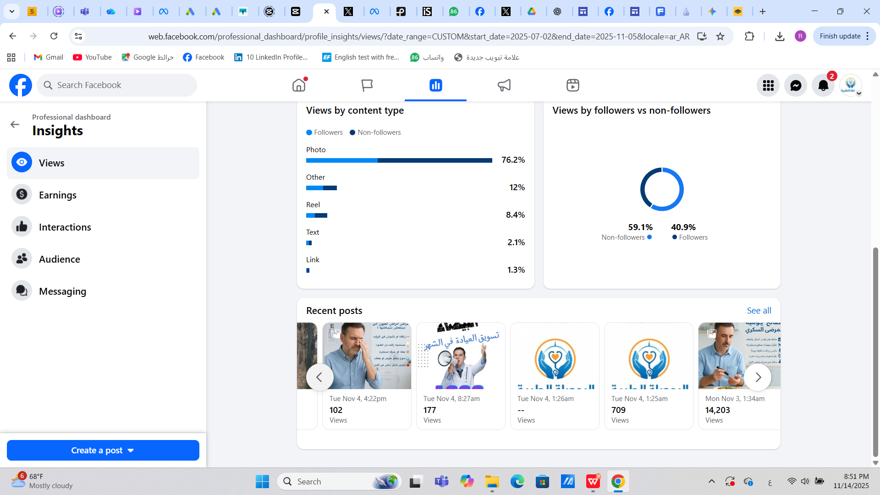

Slide 10
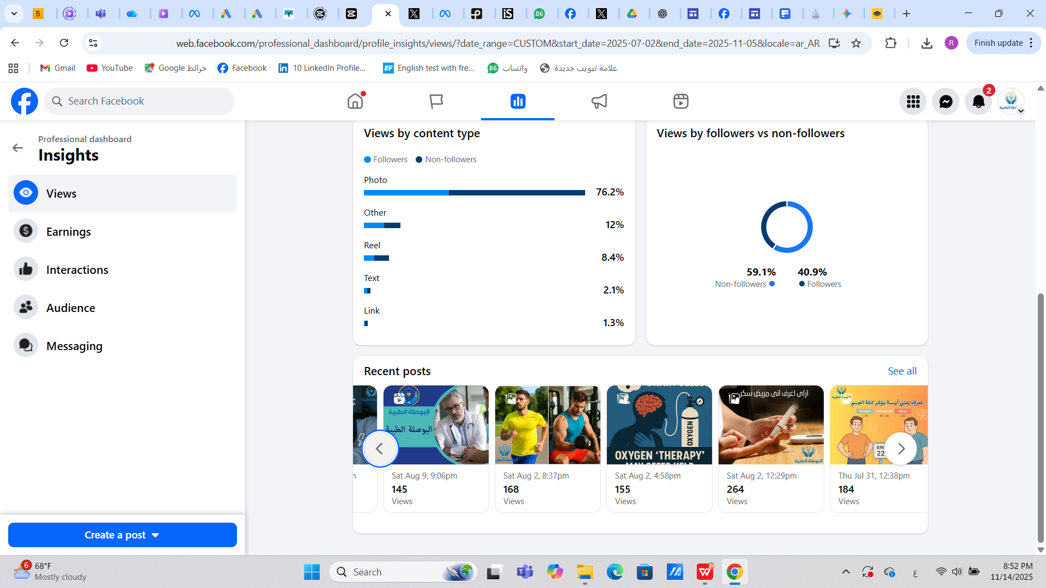
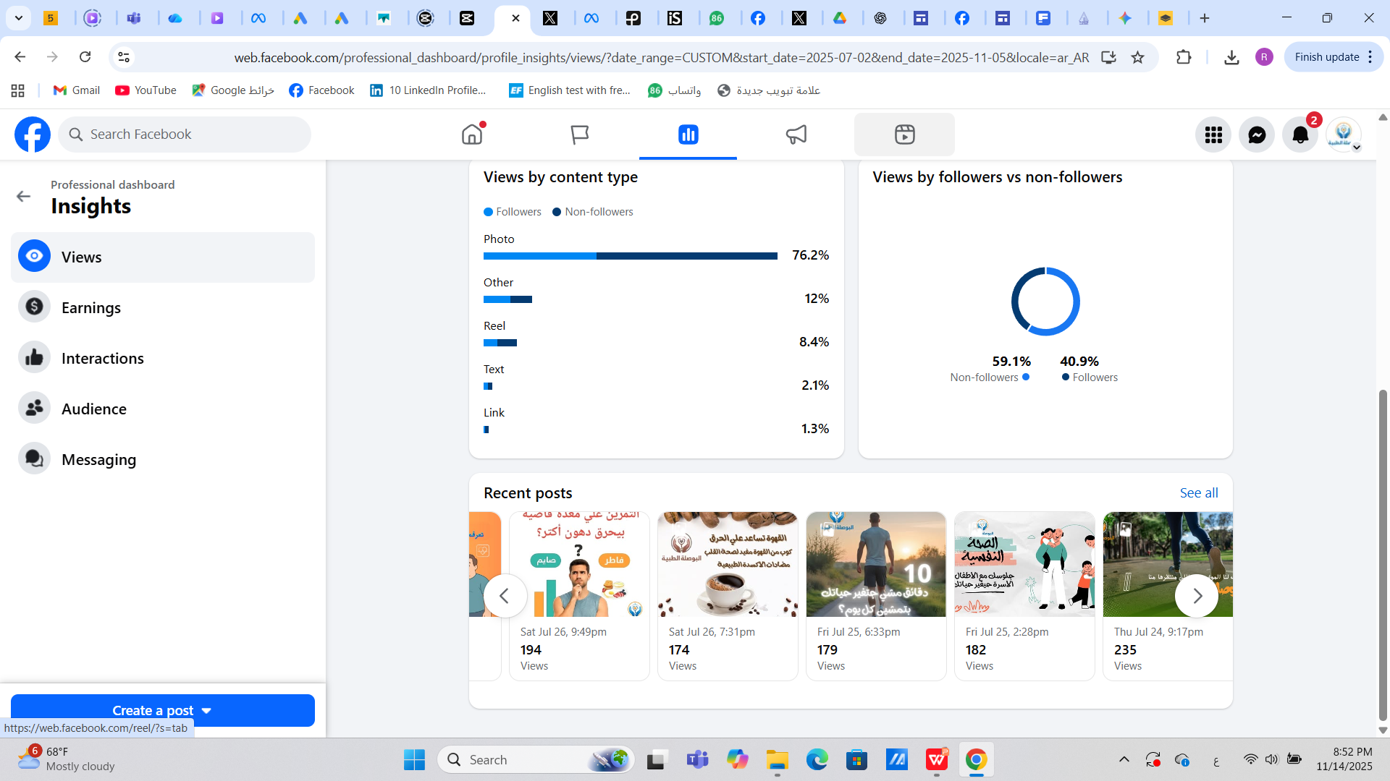

Slide 11
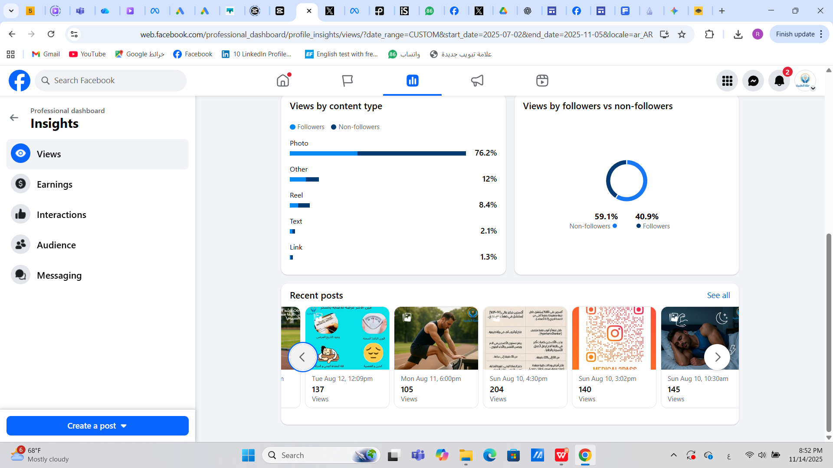

Slide 12
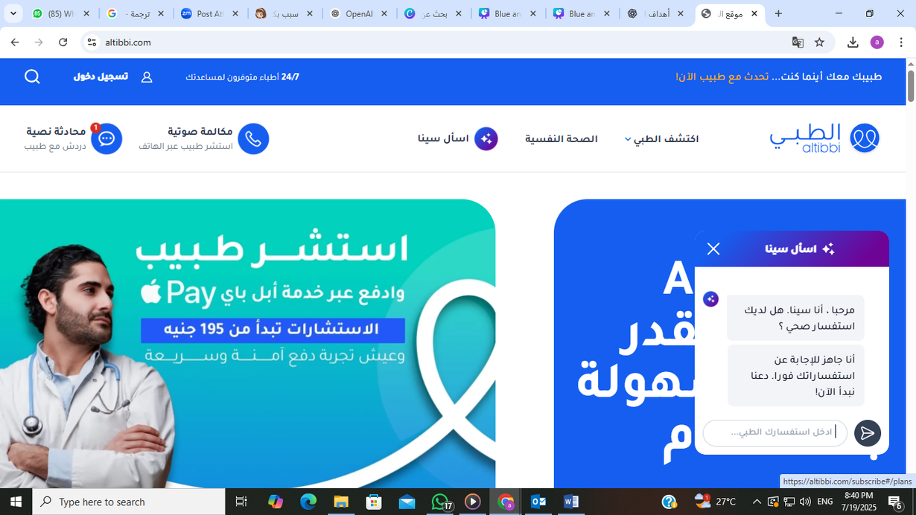
Compatitve Analysis:
altibbi
A full-service medical platform offering a mobile app and Facebook page, allowing users to book appointments across all medical specialties.

Slide 13
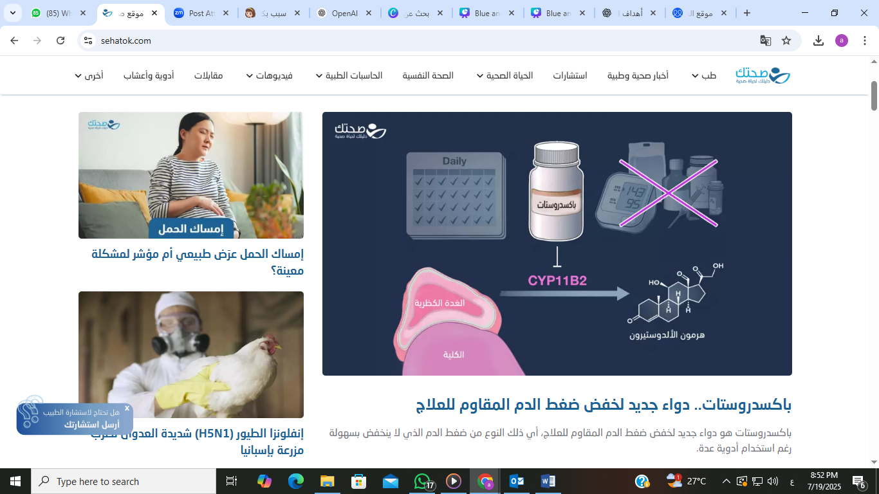
sehatak
comprehensive medical platform available through a website

Slide 14
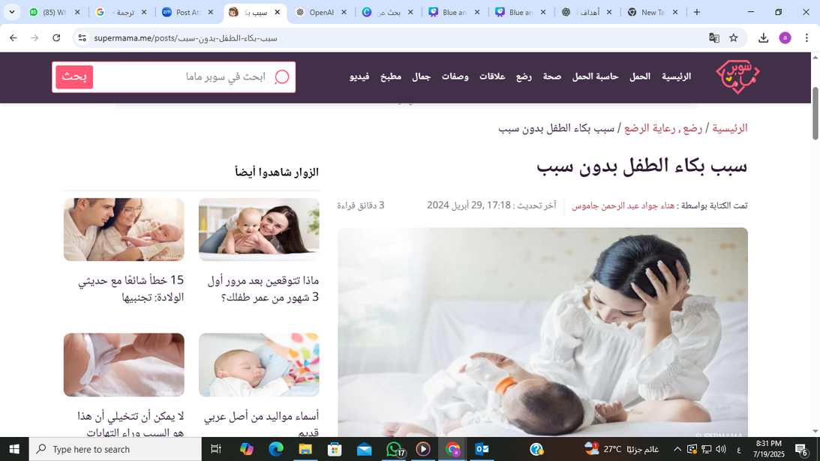
Super Mama
A specialized website for mothers and children

Slide 15
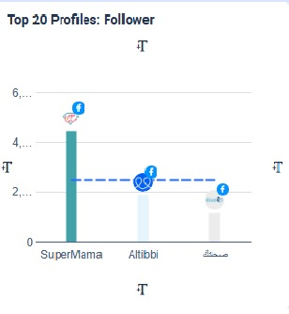
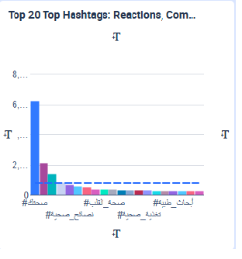
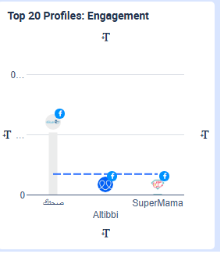

Slide 16
Segmentation and Buyer Persona
it’s essential to segment the audience based on:
Who needs the information
How they use the internet

Slide 17
Demographic Segmentation
age group:
Focus on ages 18 to 50 with customized content for:
Younger audiences (e.g., child nutrition)
Older audiences (e.g., elderly care)
Gender:
Content targets all genders, with specific topics tailored for:
Women: maternal health, reproductive wellness
Men: chronic conditions like hypertension
Education Level:
Focus on an educated audience or those interested in self-learning
Students, graduates, professionals

Slide 18
Geographical Segmentation
Location:
The content is mainly targeted at people in Egypt, using simple, clear Arabic that is easy to understand across different dialects.
Usage Patterns:
Most users access content via mobile devices, especially from major cities like Cairo and Alexandria. So, all content should be mobile-friendly in format and design.

Slide 19
Buyer Persona : Mother
Age: 30 – 50 years old
Gender : Female
Location : Urban & suburban Egypt (Cairo, Giza, Alexandria, Mansoura,
etc.)
Education: High school – University
Occupation : Homemaker or part-time worker
Economic Level : Middle

Slide 20
Psychographics
• Core Values: Family well-being, children’s education & health, stability
• Interests: Parenting groups, school-related health topics, family nutrition,
religious/spiritual well-being
• Lifestyle: Busy with household duties, relies on online communities & TV for
information, trusts recommendations from other mothers
Digital Behavior
• Platforms: Facebook (mom groups, health pages), WhatsApp groups, YouTube
(parenting & health tips)
• Content Preference: Simple Arabic explanations, parenting-focused advice, short
practical videos, infographics to share in groups

Slide 21
Pain Points
• Anxiety about children’s mental & physical health
• Difficulty finding reliable medical advice online in Arabic
• Worry about social stigma if her child needs psychological support
• Overwhelmed with misinformation from social media
Goals
• Ensure her children’s health & mental well-being
• Learn how to spot early signs of stress/anxiety in kids
• Get simple, practical advice to apply in daily family life

Slide 22
Content Plan
awarness | posts about the defention and sign and symptoms of diseases like diabetes educational posts and reels tips post polls infograph

Slide 23
Content Plan
Engagment | week | content
 | week1 | انفوجرافبيك عن الاعاراض المبكرة لمرض السكر فيديو دكتور بيرد على سؤال مهم
 | week 2 | ريلز عن معلومة صحية قصيرة فى 30 ثانية استورى شاركونا العادات المفيدة الى بتعملوها فى الصباح او قبل النوم
 | week 3 | تصميم بسيط عن تصحيح مفاهيم مغلوطة poll بتنام كام ساعة فى اليوم و نقدر نحسب قدرتك الانتاجية
 | week 4 | CTA

Slide 24
Content Plan
type of campaign | week | type of content
increase the number of followers | week 1 | carousal , trending reel مع معلومة صحية قصيرة , meme , post : myths vs fact
 | week2 | reel تمارين مكتبية سريعة , story quiz , post هل تعلم , carousal اطعمة تقوى المناعة
 | week 3 | infograph حقائق رقمية , story : ask me anything , meme او صورة خفيفة
 | week 4 | reel باحصائية رقمية post اقتباس او كلمة ملهمة من طبيب معين

Slide 25
type of campaign | week | type of content
increase the number of content | week1 | reel(معلومة فى 10 ثوانى ) كاورسيل اخطاء شائعة فى اسلوب الحياة post: myths vs facts
 | week2 | video عن الاعراض الشائعة و المضاعفات لمرض السكر post اطعمة تنظم مرض السكر
 | week 3 | reel يوضح الفرق بين التمارين المختلفة زى الكارديو و المقاومة story poll عن اى موضوع جديد حابين يتكلموا فيه
 | week 4 | video motion graphic يوضح ازاى نقدر نفرق بين القلق الطبيعى و القلق المرضى post : tips and tricks 5 طرق بسيطة للتعامل مع التوتر الصباحي

Slide 26

بوست تفاعلى عن الصحة النفسية
هل جربت قبل كده تاثير الامتنان على صحتك النفسية ؟
علم النفس بياكد ان ممارسة عادة المتنان (انك تكتب الحاجات اللى انت ممتن ليها فى يومك) ليها فوائد قوية :
1- بتقلل التوتر و القلق
2- بتحسن جودة النوم
3- تقوى المرونة النفسية فى مواجهة الضغوط
4- بتزود مشاعر الرضا و السعادة
مجرد كتابة 3 حاجات بسيطة يوميا انت ممتن ليها حصلت معاك زى مثلا (صديق وقف
جمبك - اكله حلوة ) بتساعد مخك يركز على الايجابيات بدل السلبيات
اكتبلنا فى الكومنتات : ايه الحاجة اللى انت ممتن ليها النهاردة
#البوصلة-الطبية #صحة نفسية

Slide 27
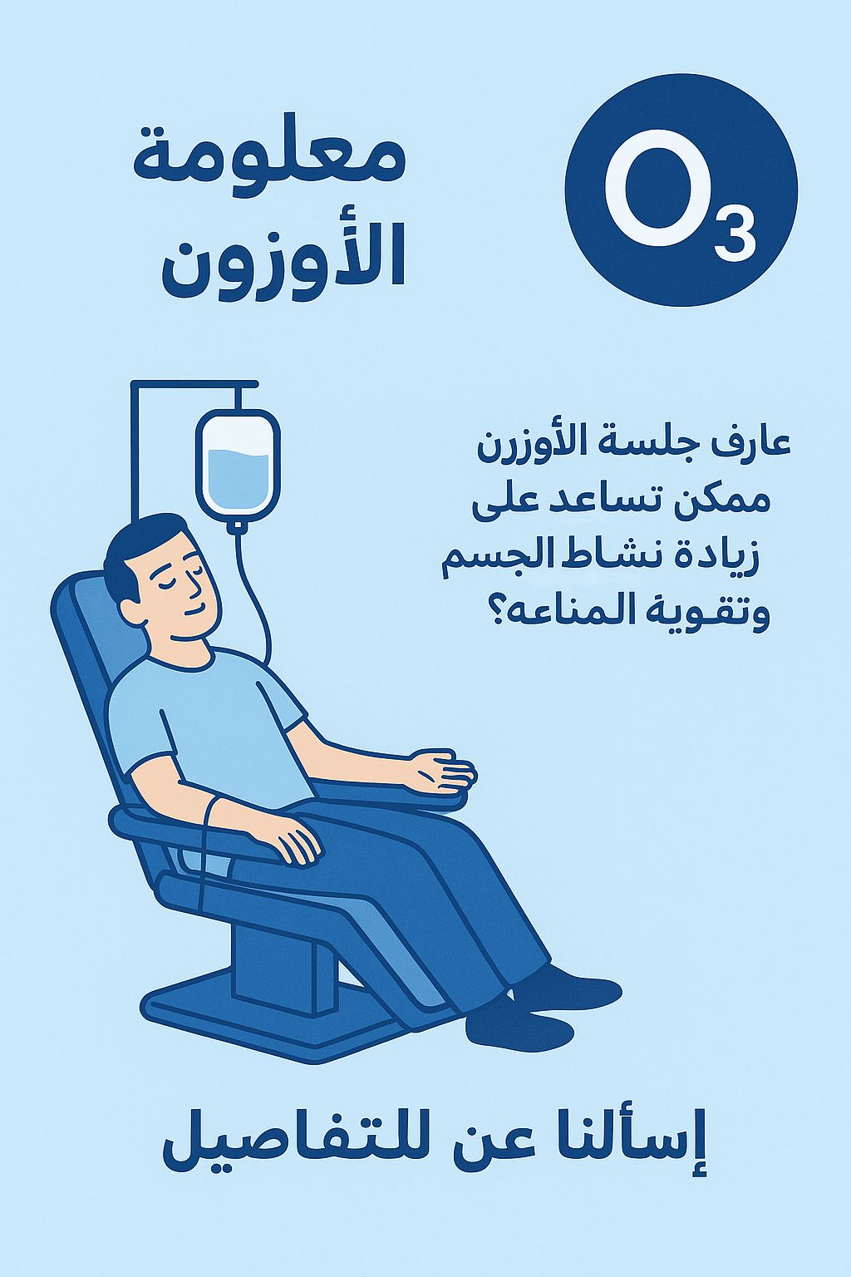
حقيقة ام خرافة ؟
“العلاج بالاوزون بيعالج كل الامراض بدون اى مخاطر “
الخرافة : في ناس فاكرة ان الاوزون حل سحرى لكل الحالات و مفهيوش أى آثار جانبية
حقيقة : العلاج بالاوزون ليه استخدامات طبية محدودة و بتم بشكل مدروس تحت اشراف طبيب متخصص
فى العلاج بالاوزون لسه فى ابحاث بتتعمل لتاكيد فعاليته و امانه
النصيحة : الاوزون مش بديل للعلاج الطبى التقليدي , لكن ممكن يكون مساعد فى بعض الحالات لما الطبيب يوصى بيه
شاركنا : سمعت ايه عن العلاج بالاوزون قبل كد؟
#البوصلة الطبية

Slide 28
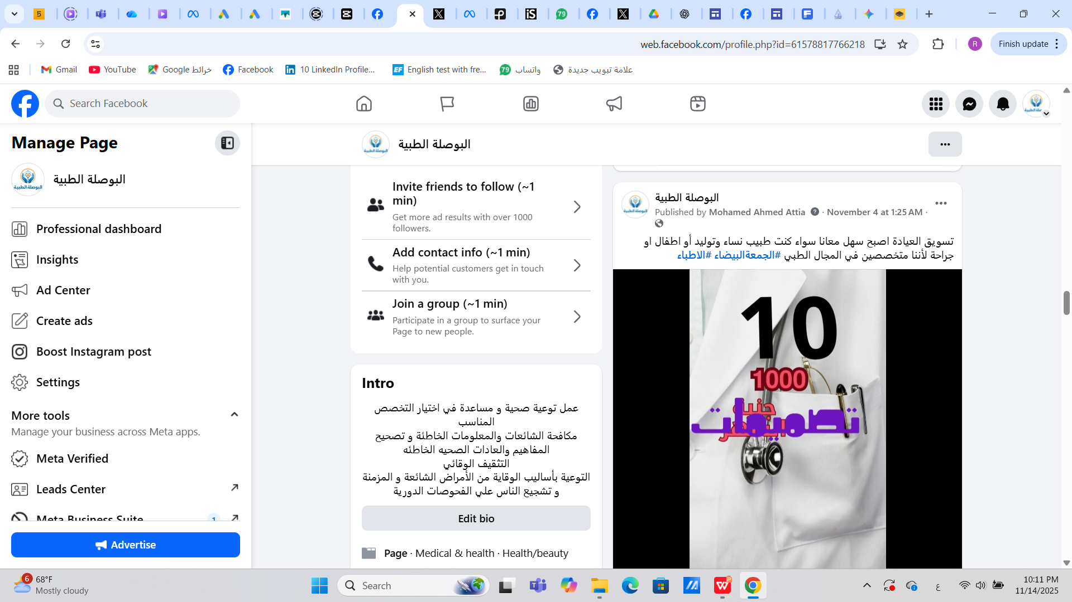
بوست تسويقي

Slide 29
Media Buying Plan
goal of the plan :
1- engagment
2- increase the number of followers
Targeted audiance:
age: 18 - 50 years
location: cairo- alexandria- upper egypt
interest : health oriented, obesity, sports

Slide 30
channels: facebook ads (reels, video, infographics, carousal )
types of campaigns:
1- engagment :(contest, posts) 30%
2- increase number of followers (carousal, video, posts) 70%

Slide 31
Budget: 1200
1- engaqgment :30% (400 EGP)
2- increase followers : 70%(800 EGP)
the content :
1- reels and videos
2- quiz and medical Q&A posts
3- short story about patients
4- snack content : myth vs fact

Slide 32
1st campagin
engagment
ad set
reel about diabetes
post about care for diabetic eye
snack post about diabetic food

Slide 33
conversion and sales
ad set 2
post about mental health
reels about the services
snack post about the difference between normal stress and anxiety

Slide 34
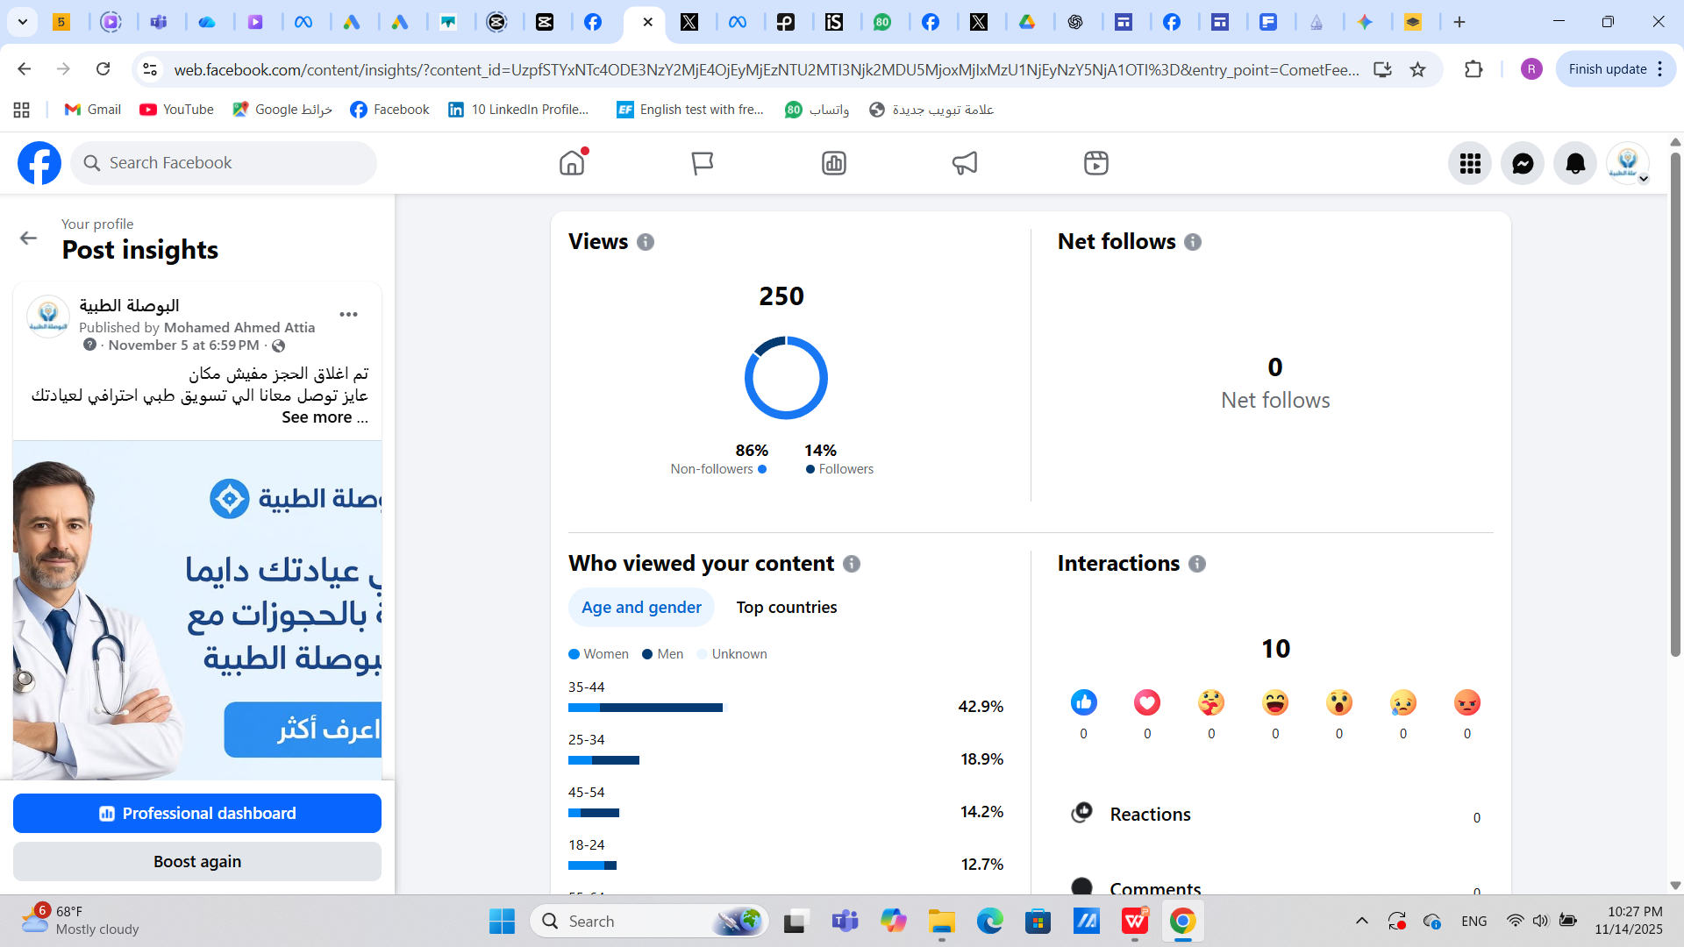

Slide 35
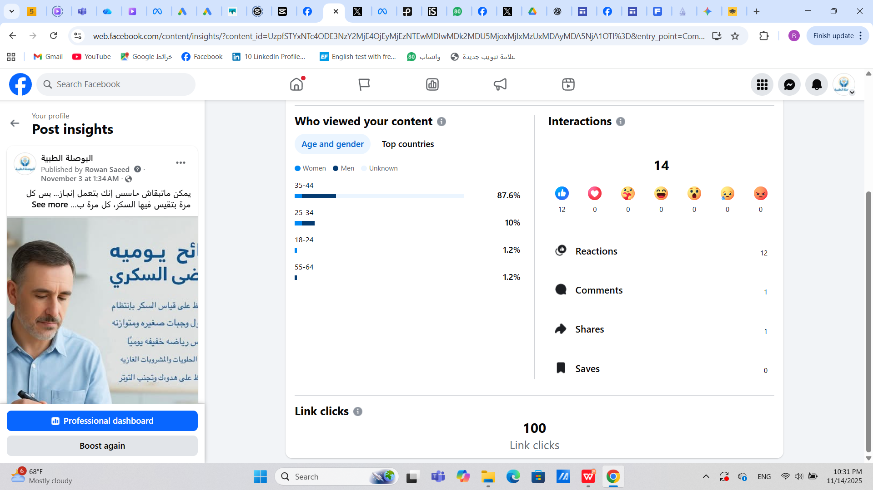
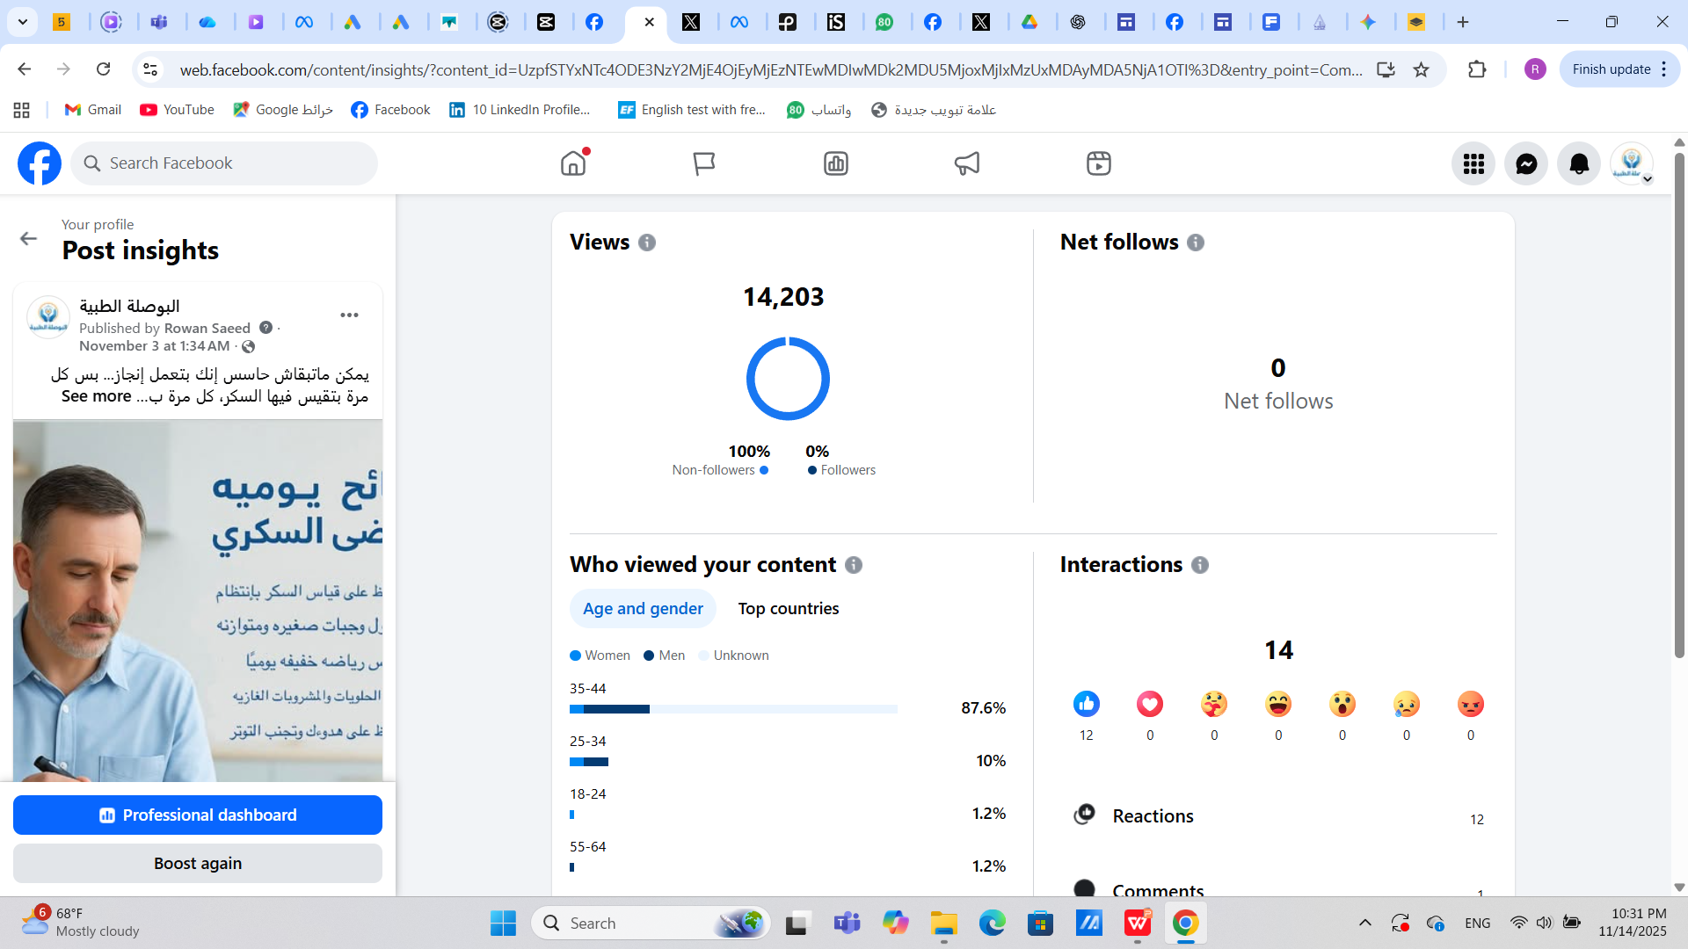

Slide 36
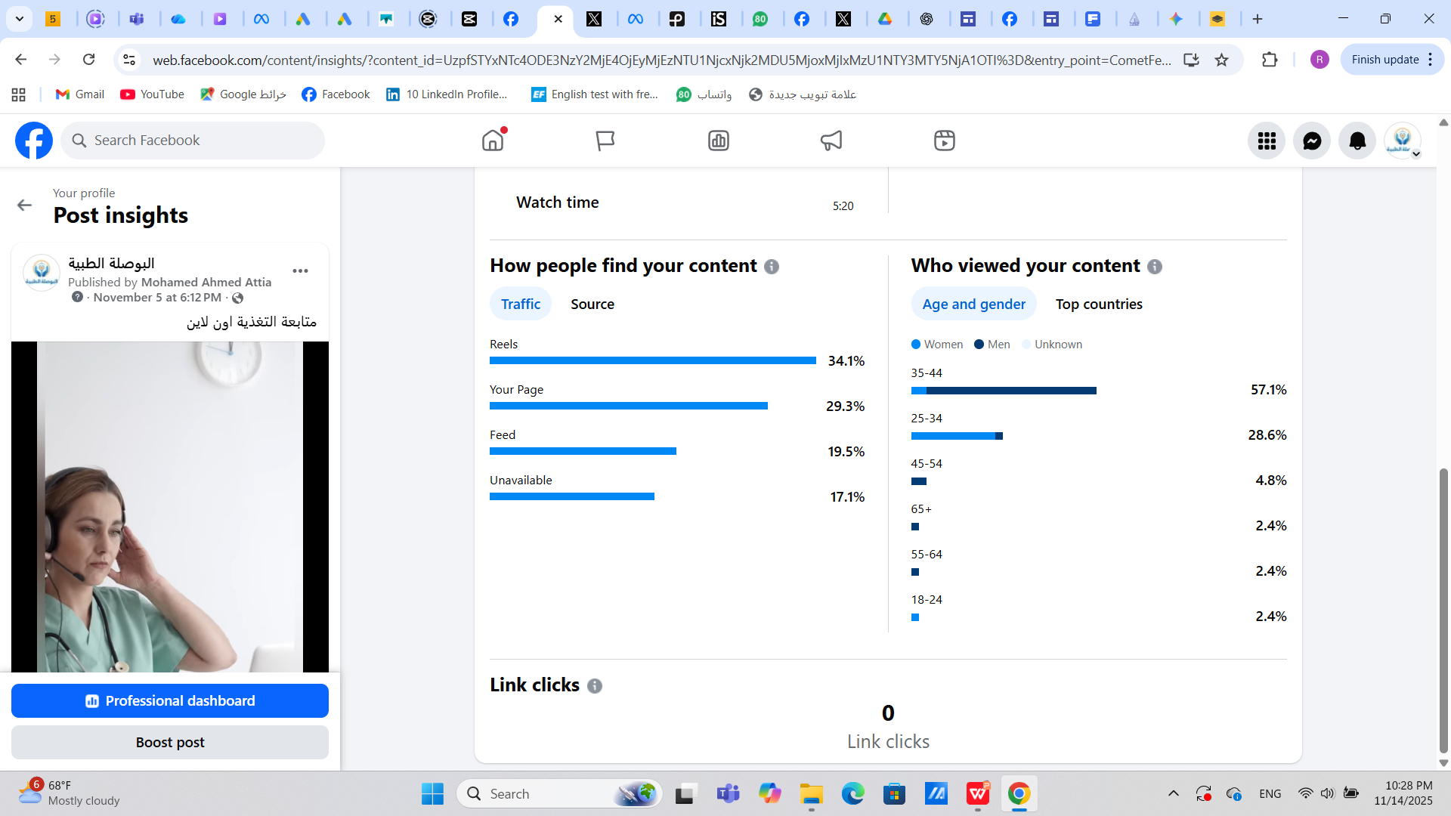
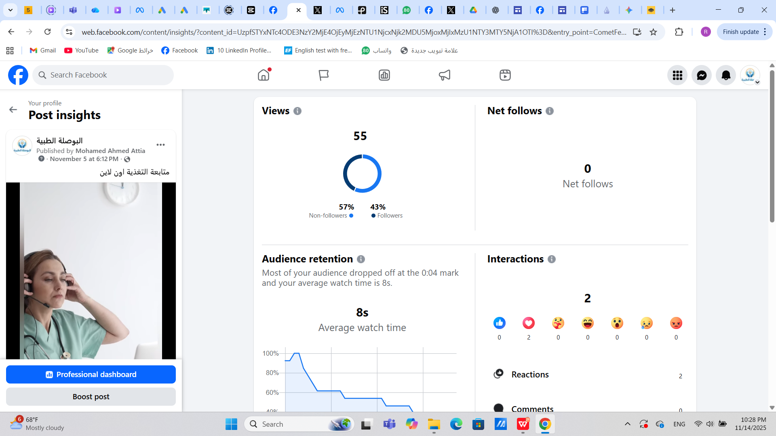

Slide 37
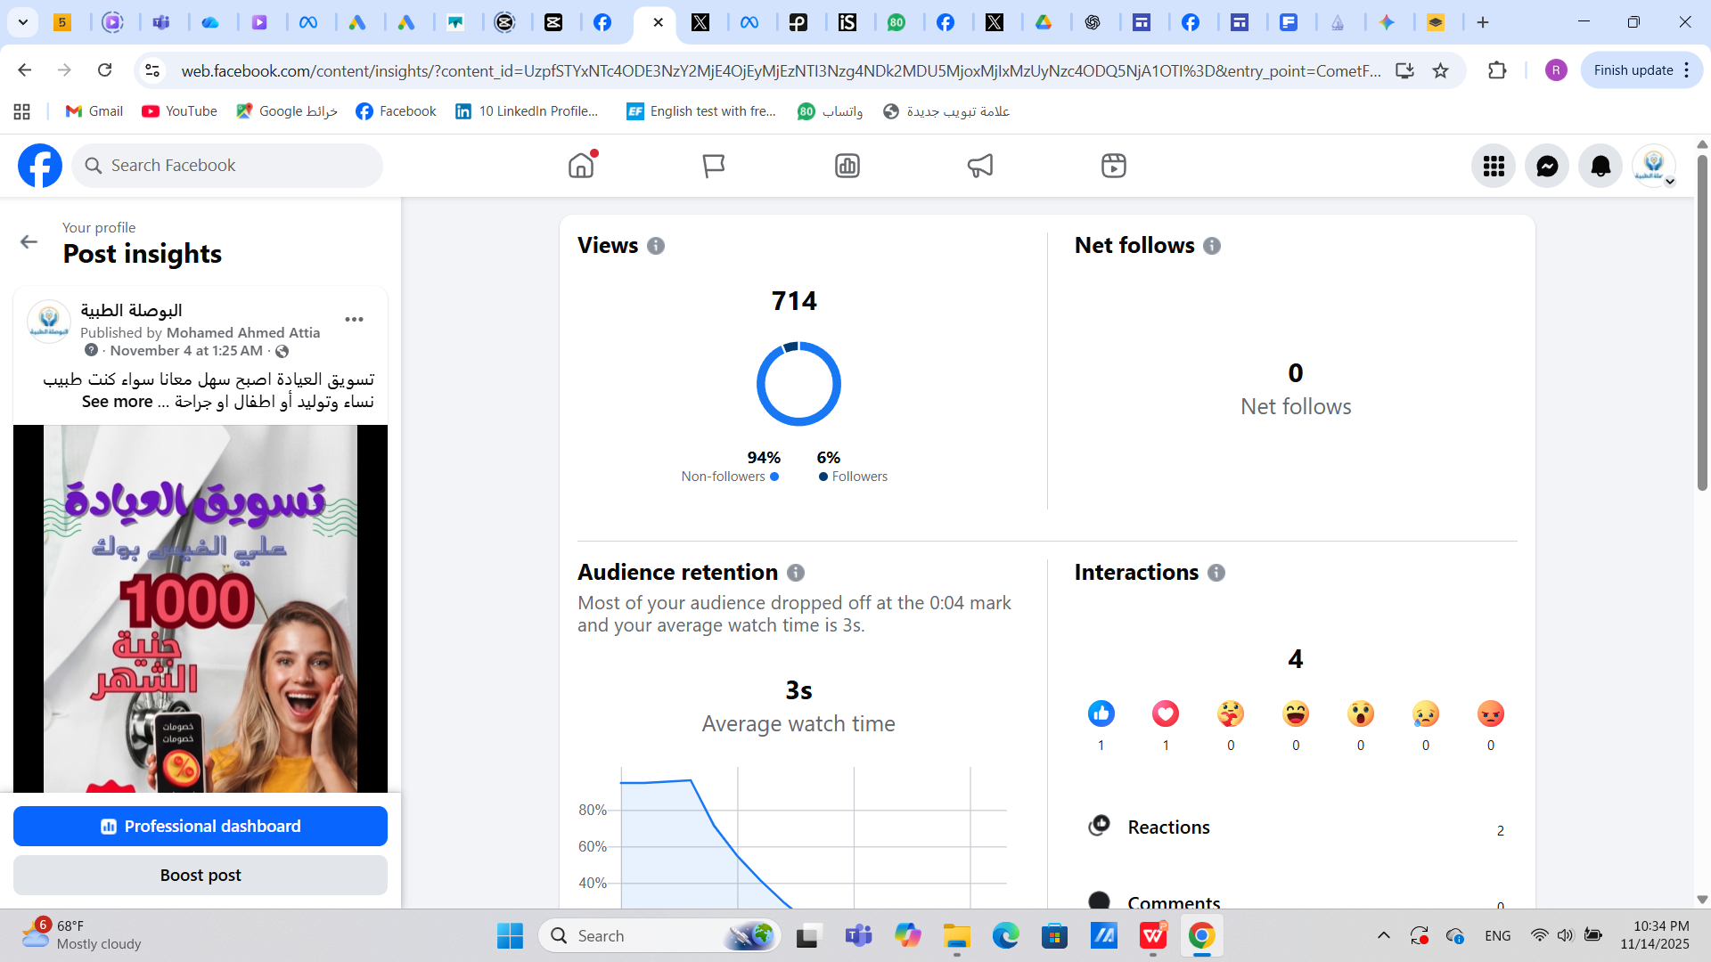
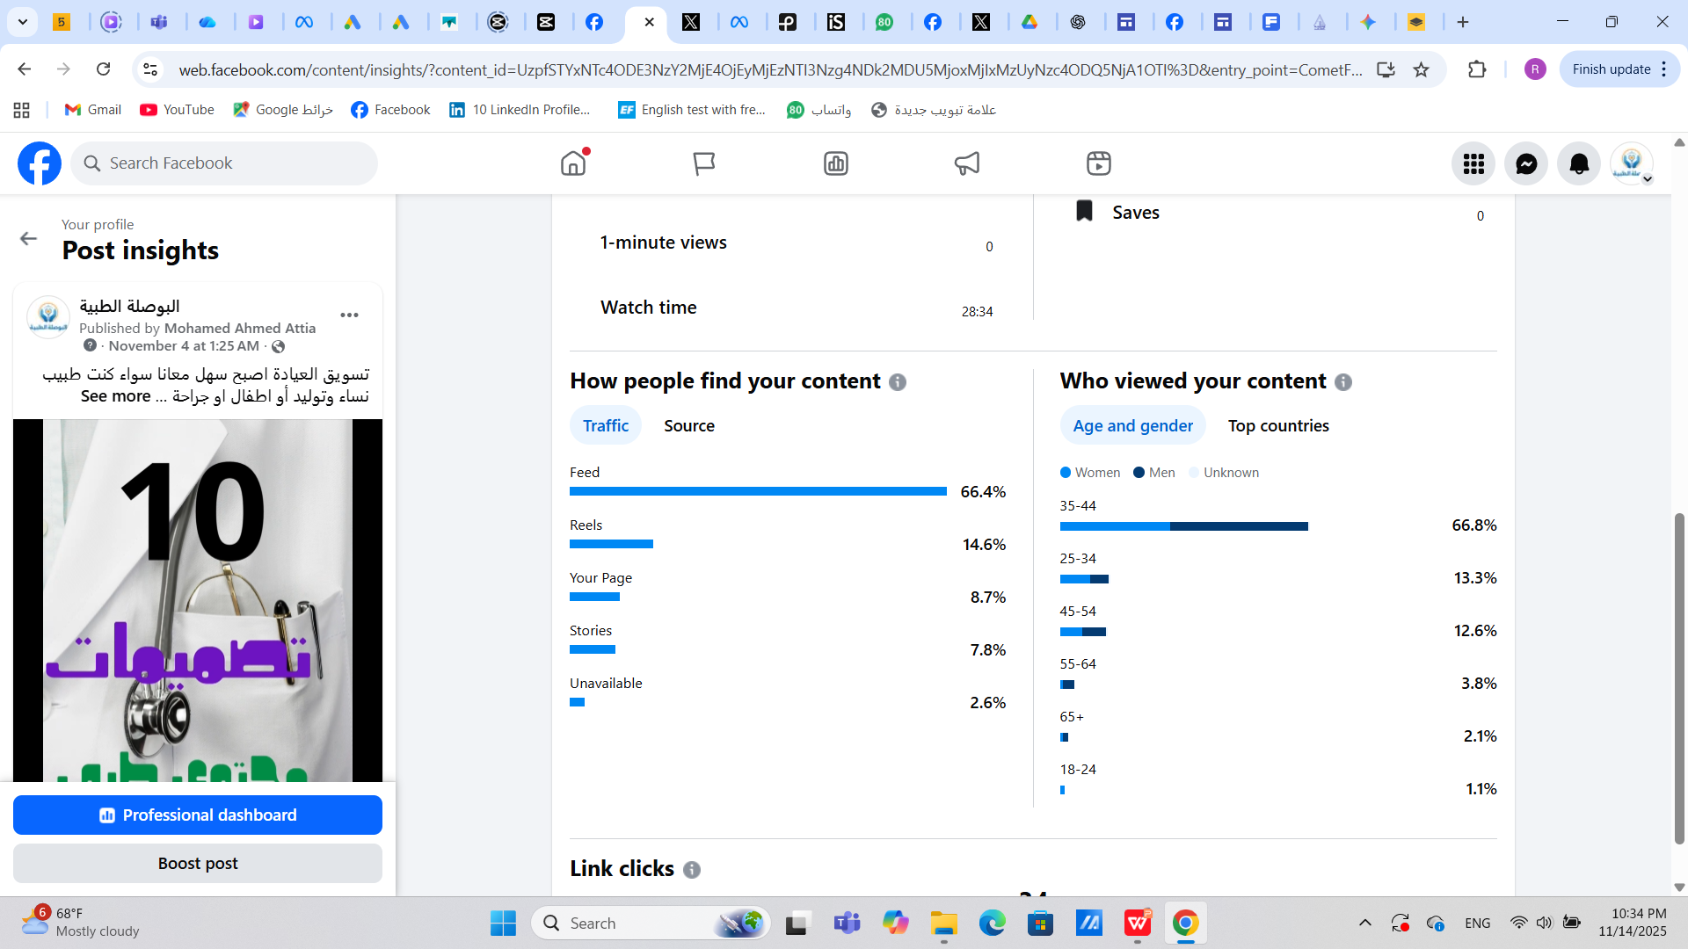

Slide 38
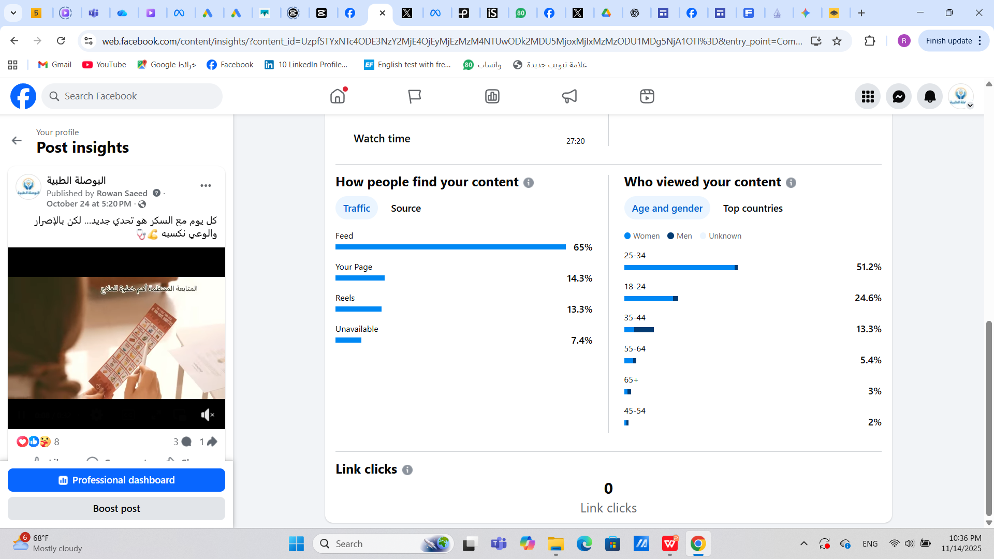
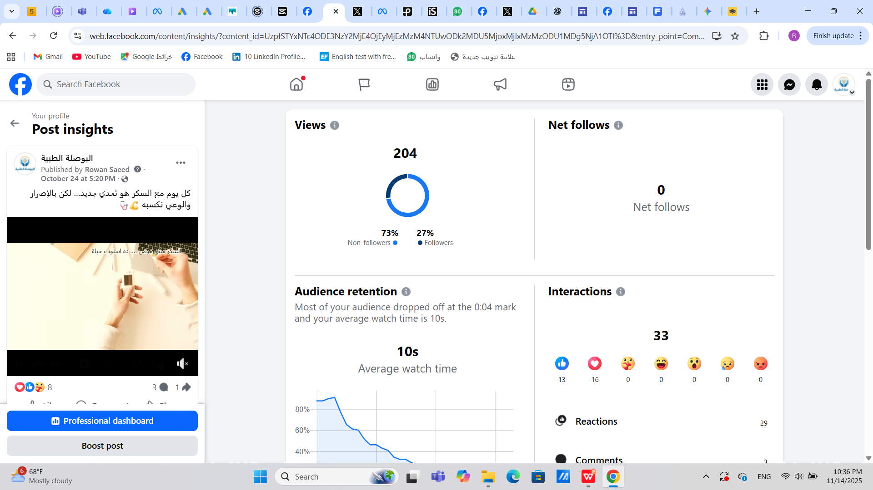

Slide 39
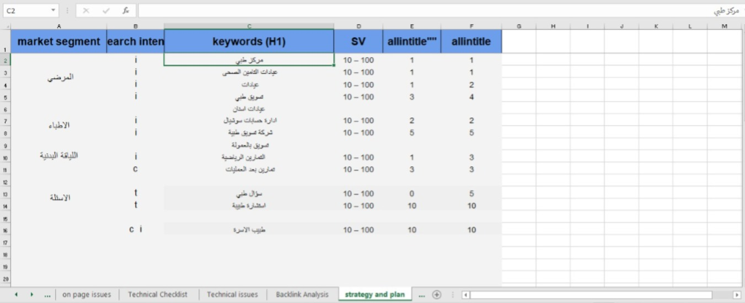
SEO Plan

Slide 40
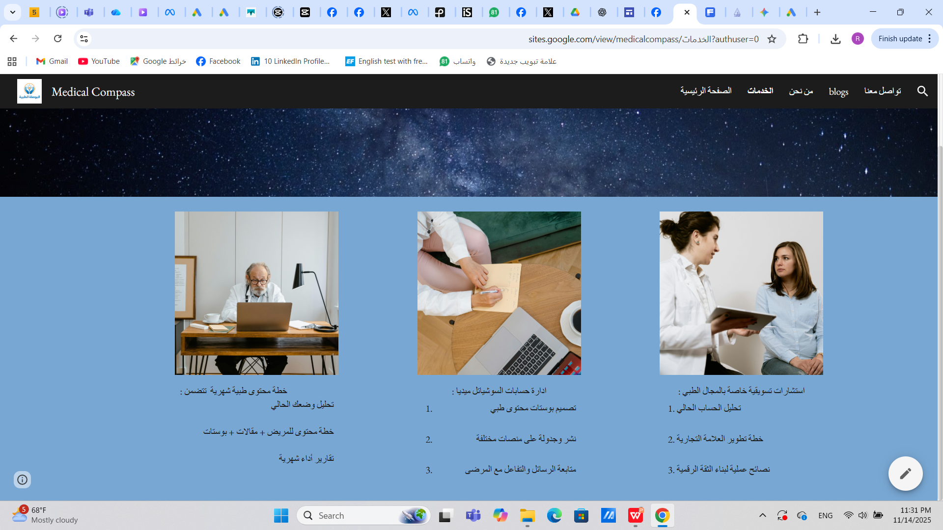
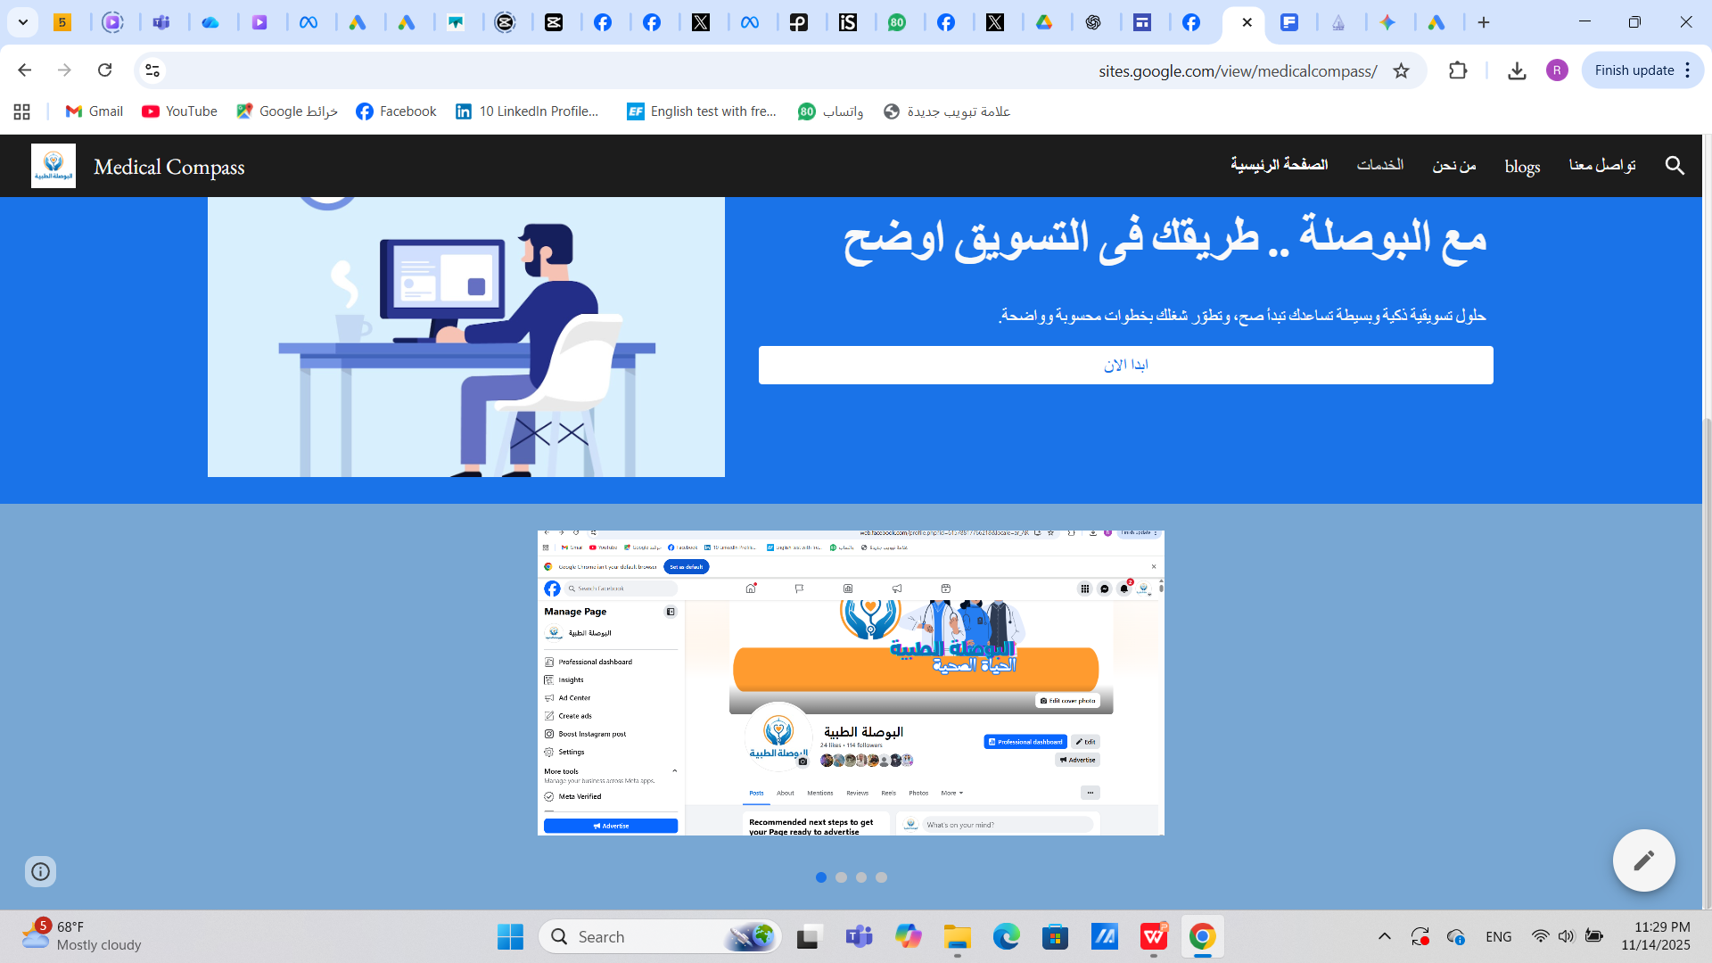
website
https://sites.google.com/view/medicalcompass/

Slide 41
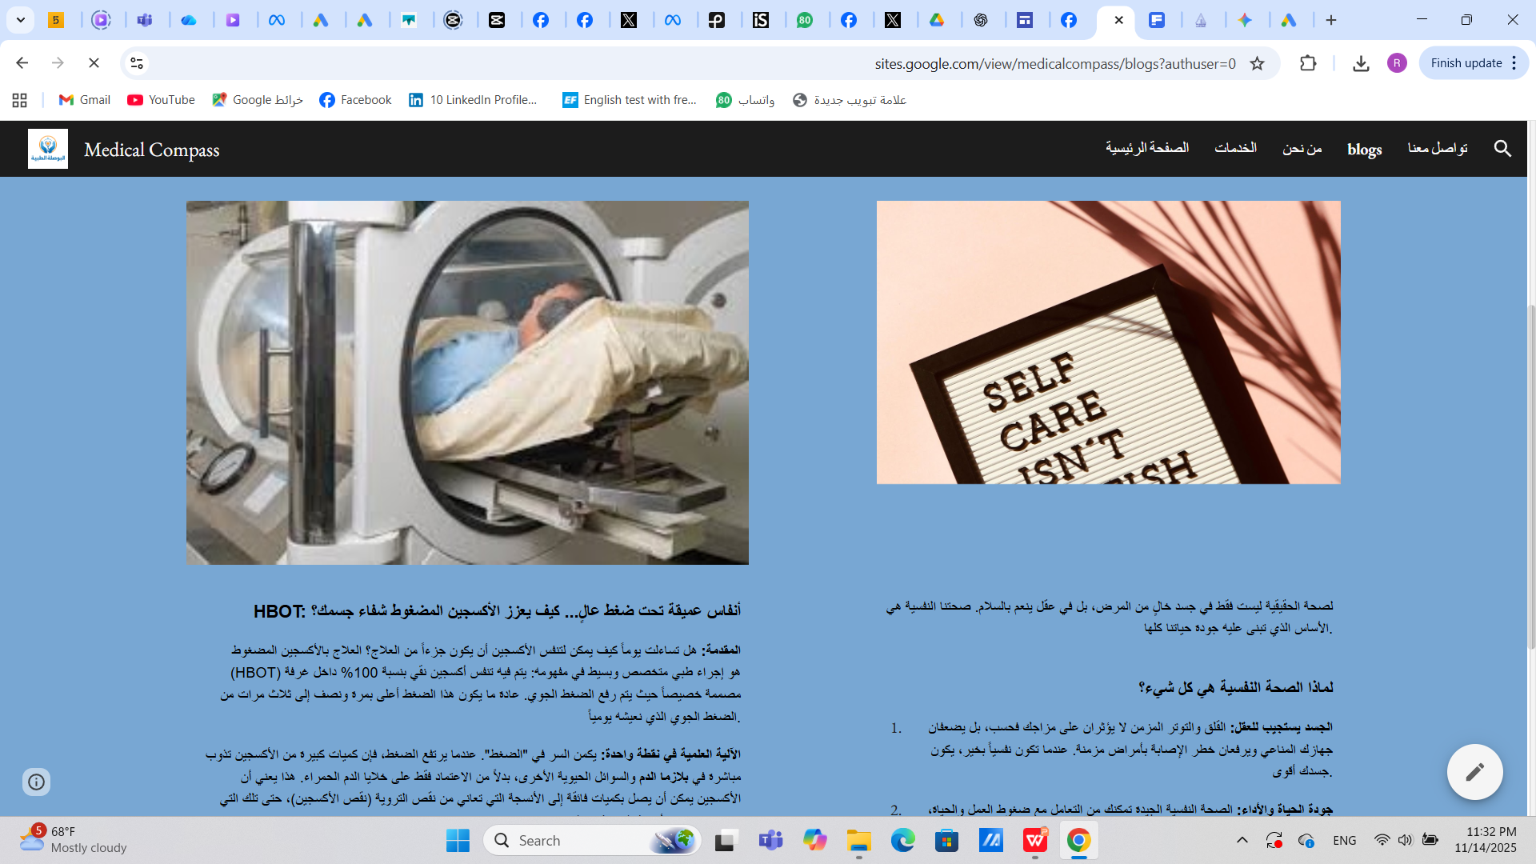
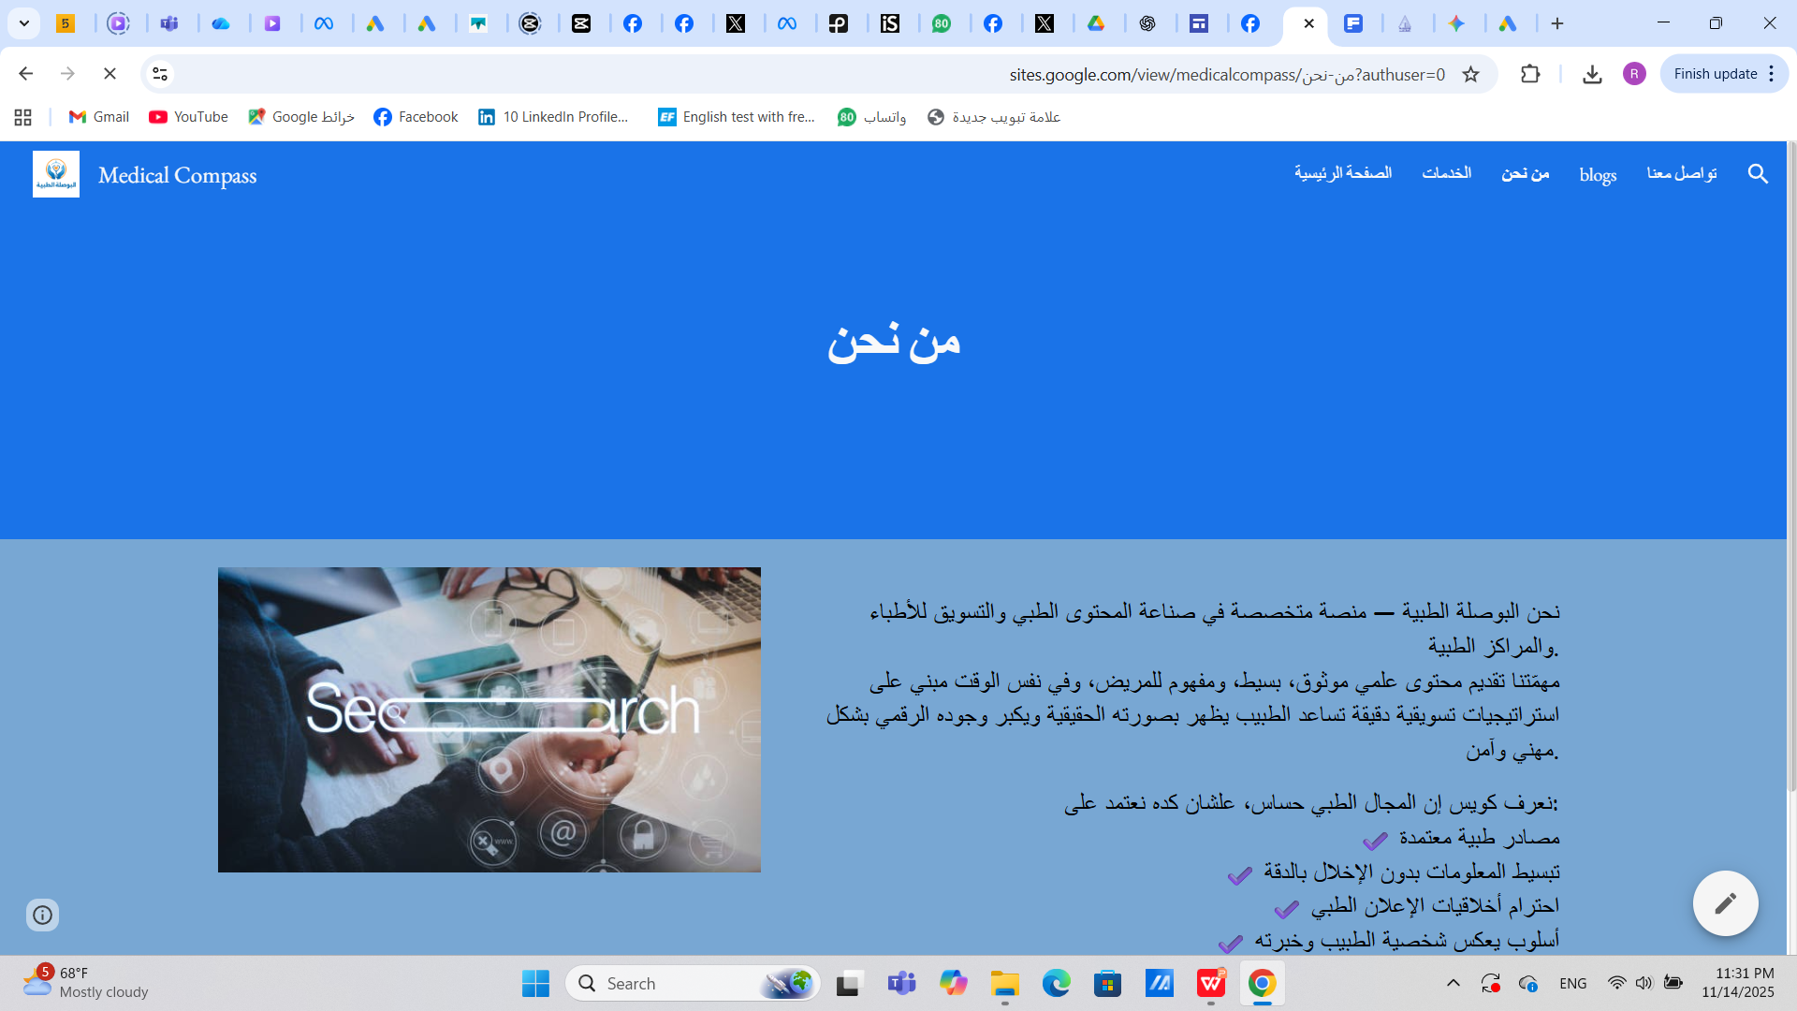

Slide 42
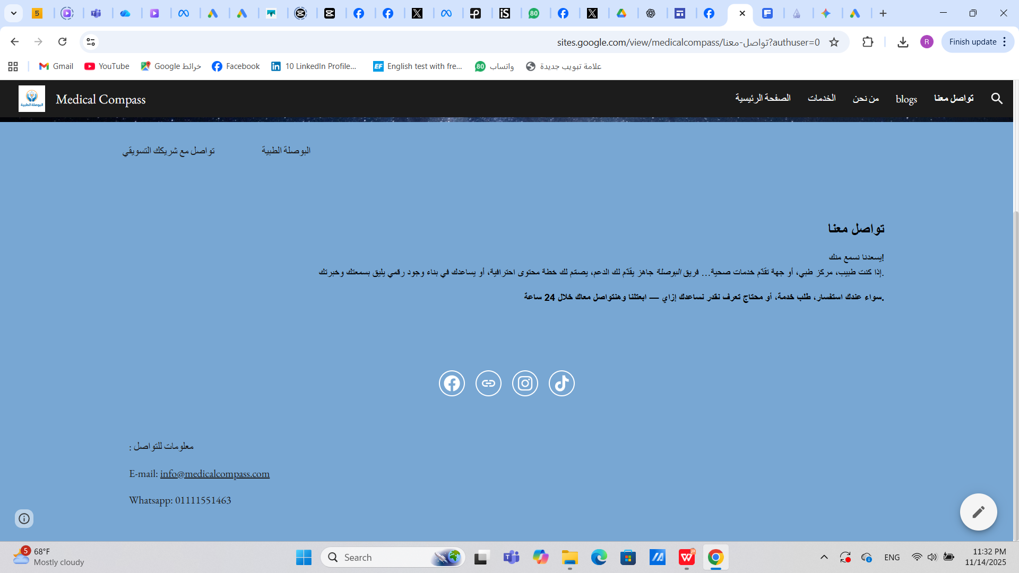

Slide 43
Performance Analysis of "The Medical Compass" Page After Advertising Campaign
Following the execution of the paid advertisement campaign on the Facebook platform, the page witnessed a noticeable rise in overall performance and audience engagement, despite the campaign being implemented with a relatively limited budget.
Key Results:
Follower Growth: The number of followers increased from 90 to 110 followers within a short period.
Increased Engagement: The engagement rate significantly increased, with some Reels reaching over 600 views.
Post Virality: Posts transitioned from having 0 shares to achieving up to 10 shares per post.
Interaction Boost: Comments and likes clearly and noticeably increased.

Slide 44
Initial data indicates that the most engaged segment is women aged 25 to 45, due to the nature of the medical services presented on the page.
Conclusion:
The advertising campaign demonstrates that, despite the limited budget, it achieved positive results and significantly impacted the audience's brand awareness. This marks a successful step towards building a stronger digital presence for "The Medical Compass."

Slide 45
Recommendation :
Based on the analysis results, we have reached a set of recommendations that can further support the growth of the page:
Continue Paid Campaigns: Maintain momentum by continuing running sponsored (paid) campaigns.
Increase Visual Content Focus: Focus heavily on visual content such as videos and Reels, as they achieved high view rates and engagement.
Implement Sustainable Budgeting: Design campaigns with a simple yet continuous budget, ensuring sustained presence rather than large, sporadic efforts.
Optimize Page Call-to-Action (CTA): Improve "The Medical Compass" page by adding a direct booking or inquiry button
Prioritize Target Audience Content: Emphasize medical awareness content that specifically appeals to the most engaged demographic (women aged 25–45).
Monthly Performance Measurement: Measure and analyze results monthly to accurately identify the most effective content types and optimize future strategy

